Slide 1
SHOCK
DR . RATI PRABHA
ASSOCIATE PROFESSOR
KGMU

Slide 2
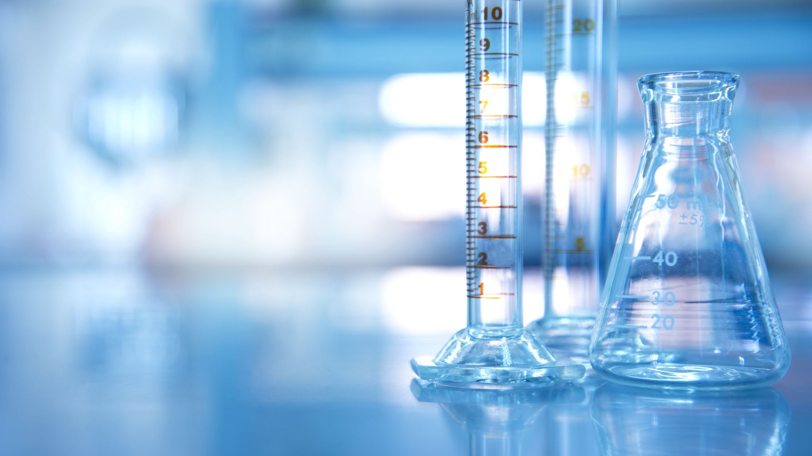
Definition
Shock is the clinical condition of organ dysfunction resulting from an imbalance between cellular oxygen supply and demand.
Imbalance between cellular oxygen supply and demand:
decreased supply,
increased demand, or
inadequate oxygen utilization

Slide 3
This leads to anaerobic metabolism, production of lactate, cell damage, organ dysfunction.
If not treated immediately causes multiorgan failure and death.

Slide 4
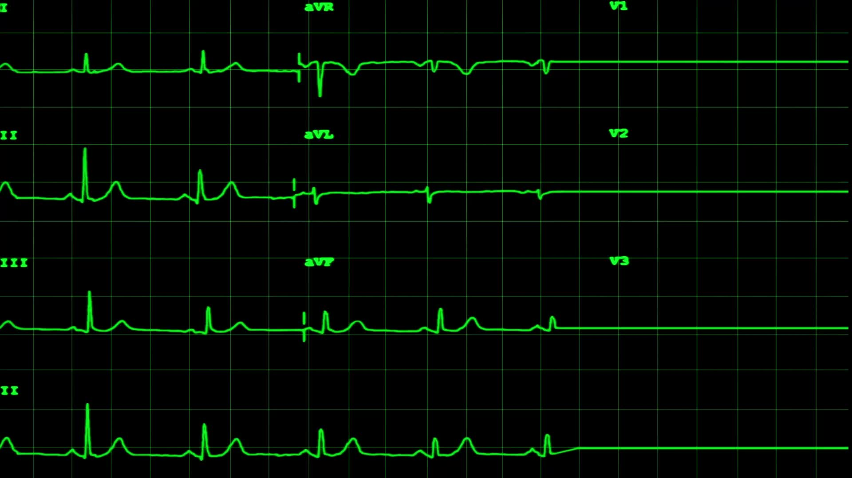
COMPENSATORY RESPONSES
Decreased MAP stimulate baroreceptor reflex by sympathetic stimulation causes increase HR and stroke volume.
Adrenal medulla releases adrenaline and noradrenaline, causes peripheral vasoconstriction, leads to ↑SVR and MAP.
If shock persists(late response), renin is release, RAS is activated causing systemic vasoconstriction.
Aldosterone causes sodium and water reabsorption and increase plasma and increase MAP and CO.
ADH from posterior pituitary gland causes sodium and water reabsorption

Slide 5
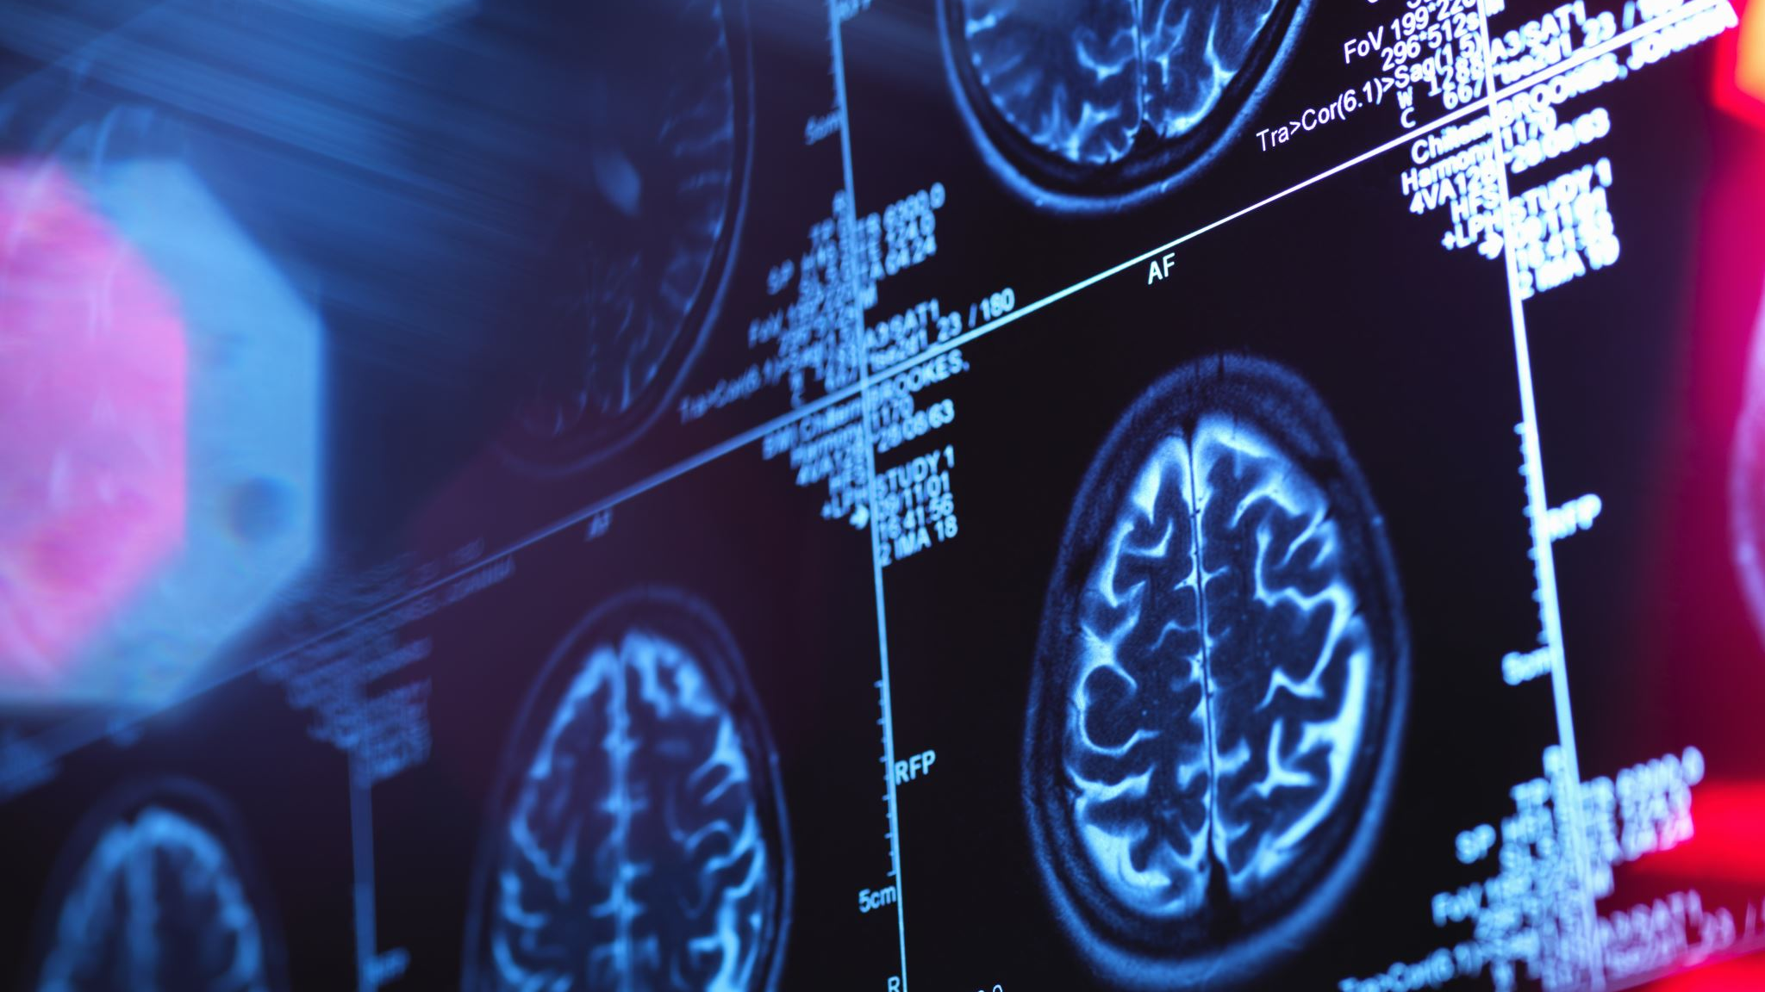
Features
Tachycardia, weak and thready pulse
Hypotension
Tachypnea/dyspnea and shallow breathing
Skin: cool, clammy, mottled skin except distributive shock
↑capillary refilling time (normal<3 seconds)
Oliguria (<0.5 ml/kg/hr)
Mental state changes seen in advanced and decompensated shock.
ST elevation.

Slide 6
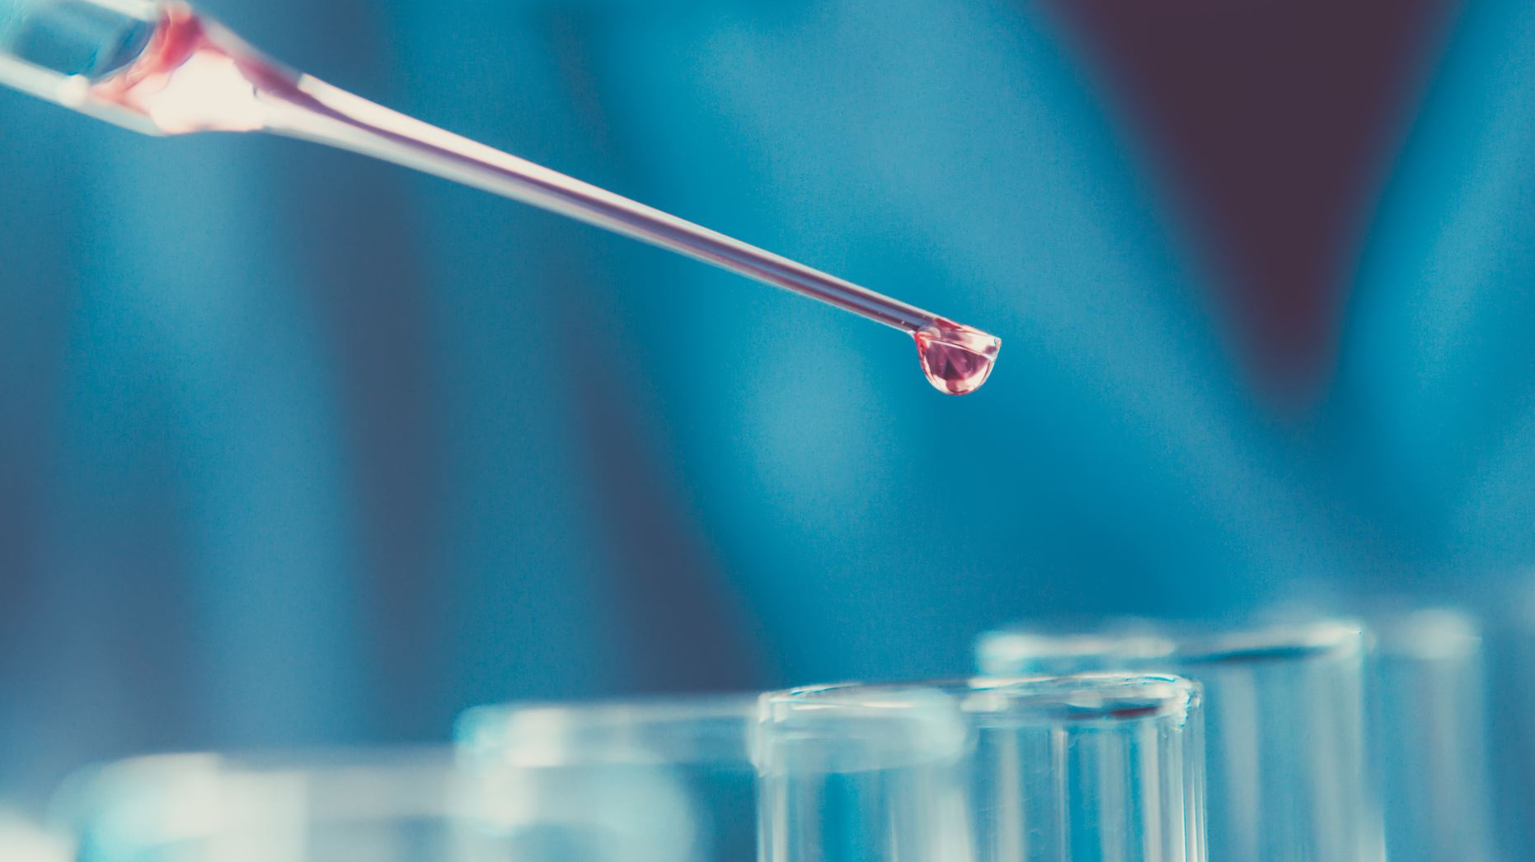
Lab values

Slide 7
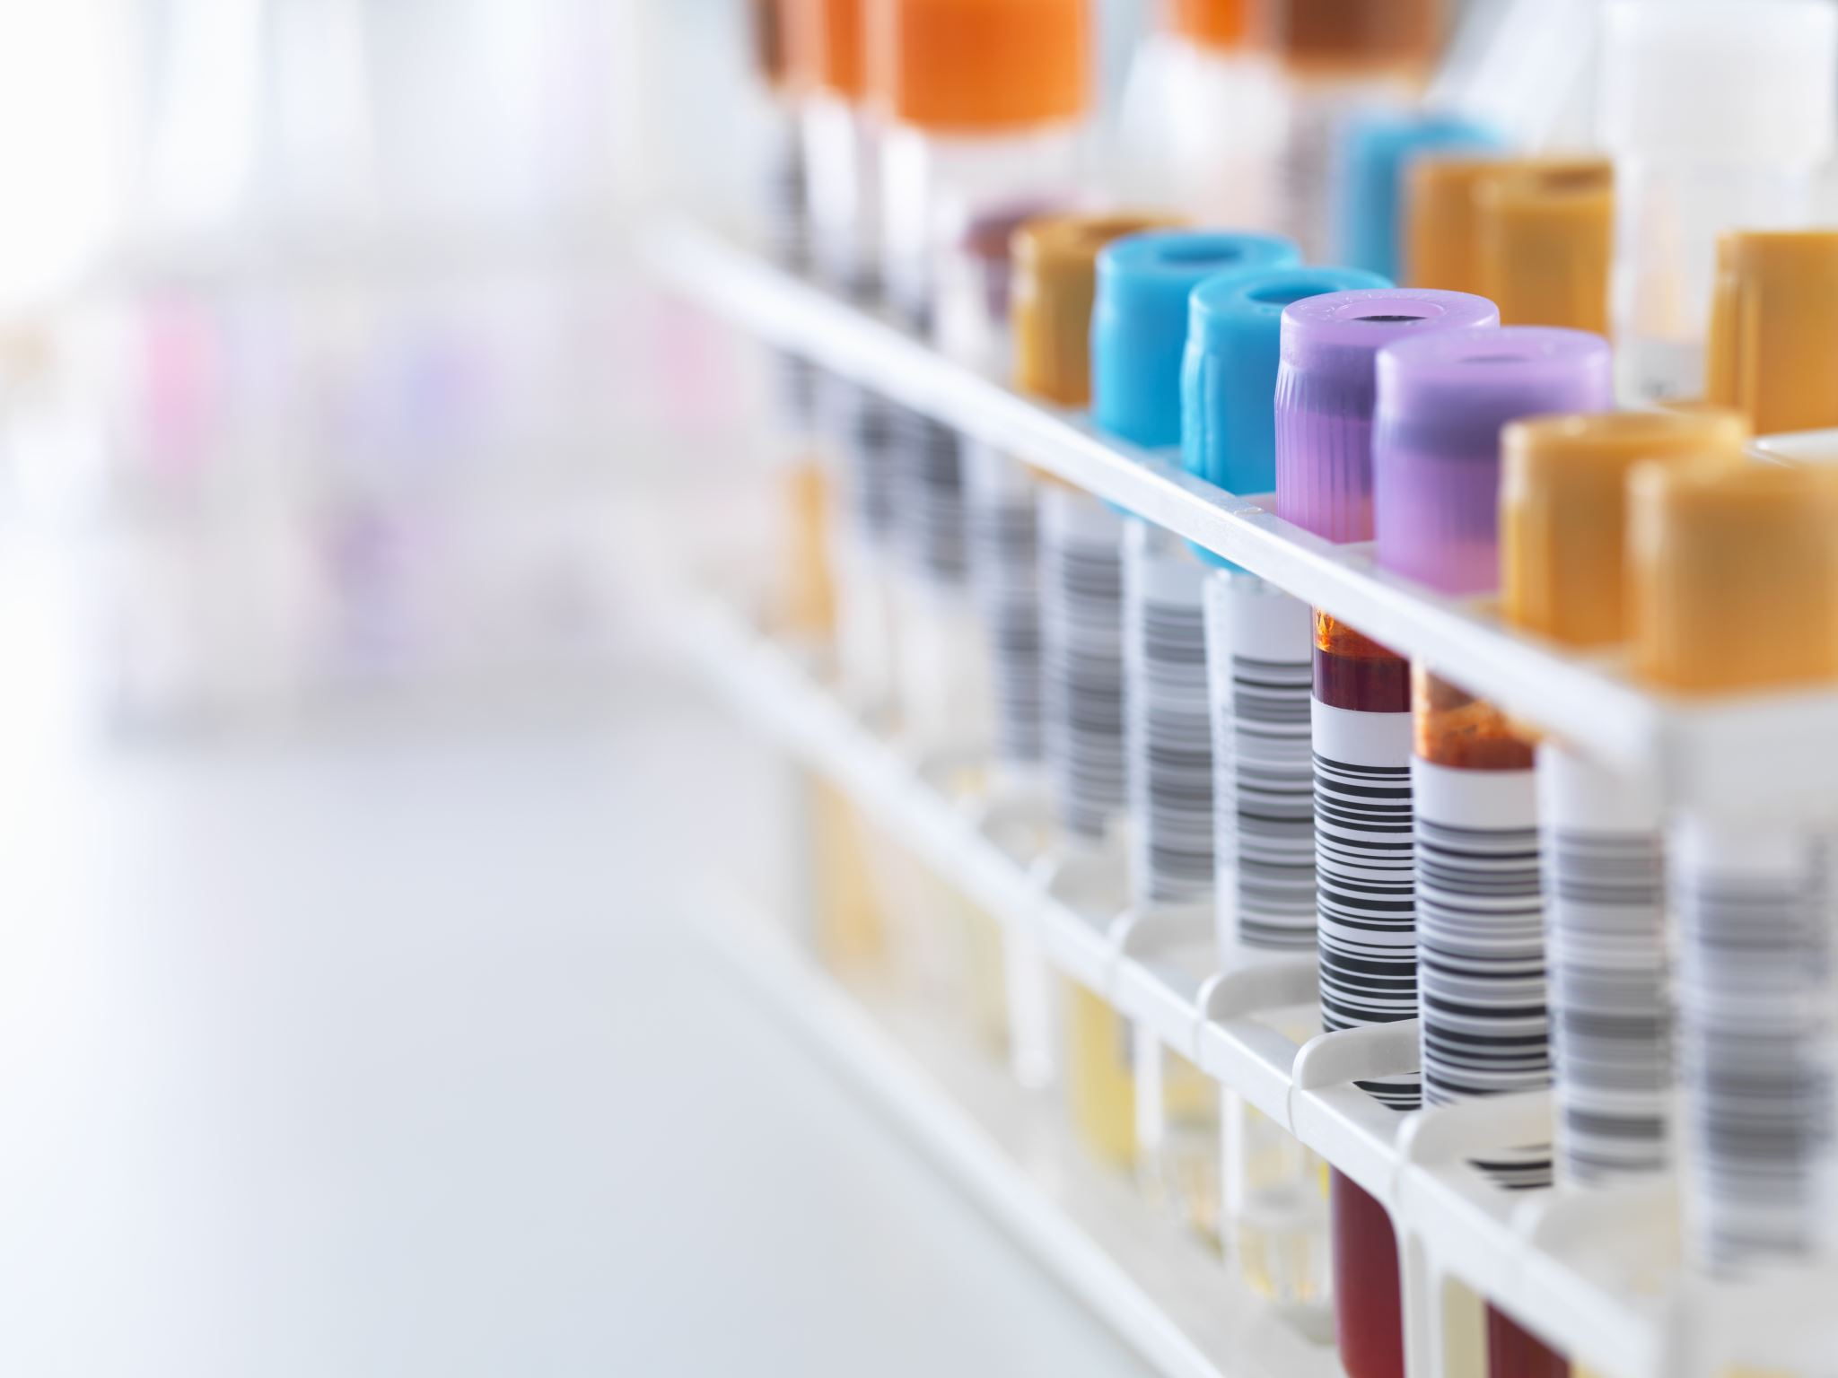
Increased lactate
Decrease pH ( metabolic acidosis)
Increased BUN and S. creatinine
Increased ALT and AST
Increased troponin and proBNP
Decreased SvO2 (except septic shock)

Slide 8
Stages
Compensated Shock (pre-shock)
Decompensated Shock
Irreversible Shock

Slide 9
Compensated shock (pre-shock):
Initial Phase.
Physiological responses counteract the initial insult and attempt to reestablish adequate perfusion and oxygen delivery
No obvious signs of organ dysfunction- difficult to recognize
E.g. mild increase in lactate/creatinine
But treatment is easy.
E.g:- 10% body blood volume loss in hemorrhagic shock.

Slide 10
Decompensated shock
Organ dysfunction starts, and the patient's compensatory response to the insult is overwhelmed.
Organ failure starts in this phase.
Present with symptomatic tachycardia, dsypnea, restlessness, diaphoresis, metabolic acidosis, hypotension, oliguria and cool, clammy skin.
E.g:
20 to 25% reduction in blood volume in hypovolemic shock.
fall in cardiac index to less than 2.5 l/min/m² in cardiogenic shock.

Slide 11
Irreversible shock
Signs are easily recognized
Has high mortality
Irreversible organ damage and Multi-organ failure
Hypotension becomes so severe and refractory to therapy, acidemia further depresses cardiac output and vasoplegia established
Anuria and acute renal failure.
Pt is obtundated and can lead to coma and death

Slide 12
Pathophysiologic classification
Hypovolemic
Distributive
Cardiogenic
Obstructive
Acute blood loss
GI loss
Burns
Anaphylaxis
Sepsis
Neurogenic shock
Adrenal crisis
Myocardial infarction
Arrhythmia
Cardiomyopathy
Myocarditis
Valvular heart disease
Tension pneumothorax
Pericardial tamponade
Pulmonary embolism
Aortic dissection
Mixed Shock: features of > 1 type.
Eg: Cardiac dysfunction in severe sepsis, severe burn

Slide 13
Hemodynamic features:
 | Preload CVP/PCWP | Afterload/ SVR | Cardiac Output/ Pulse pressure | Lactate | Urine output | SvO2 | Cold/clammy extremities
Hypovolemic | ↓ | ↑ | ↓ | ↑ | ↓ | ↓ | Yes
Cardiogenic | ↑ | ↑ | ↓ | ↑ | ↓ | ↓ | Yes
Obstructive | ↑/↓ | ↑ | ↓ | ↑ | ↓ | ↓ | Yes
Distributive | ↓/N | ↓↓↓ | ↑/N | ↑ | ↓ | ↑ | No

Slide 14
Hypovolemic Shock
Decreased intravascular volume:
Internal or external bleeding,
Dehydration, or
Gastrointestinal/urinary losses
Hemodynamics:
↓Preload, ↓ Cardiac output, ↓ Stroke volume, ↓pulse pressure, ↓CVP, ↑SVR
features:
Tachycardia
Cool, clammy peripheries, weak pulse
↑CRT, increased lactate
Large burn
Third space loss
Diuretic
↓ Urine output,
hypotension

Slide 16
Management
Management: identify cause and treat,
Fluid and/or blood transfusion
Dynamic indices of intravascular fluid deficit (pulse pressure variation, stroke volume variation, and passive leg raising) are preferred for diagnosing and monitoring ongoing fluid resuscitation.
Packed blood cell transfusion is needed to keep hemoglobin level >7 gm/dl.
If fluid resuscitation cannot maintain tissue perfusion, vasopressors (norepinephrine, vasopressin) are added, and a second etiology of shock is searched.

Slide 17
Distributive Shock
Mechanism
Results from widespread severe vasodilatation, leading to a condition of relative hypovolemia.
Hemodynamics:
↓ ↓ afterload/SVR,
Features:
Tachycardia
Warm peripheries,
CRT normal,
↓ Urine output,
Hypotension
Organ perfusion is decreased.
Septic and anaphylactic shock
↓Preload, N/↑ Cardiac output/Stroke volume, ↓CVP
increased lactate
↓ BP

Slide 19
Septic shock
Septic Shock- Management
Acute circulatory failure secondary to life-threatening sepsis
Management:
IV fluid bolus (30 ml/kg within initial 3 hours),
empiric antibiotics, and,
if needed, vasopressors (norepinephrine and vasopressin)
Supportive management

Slide 20
Anaphylactic shock
Severe, life-threatening allergic reaction that can occur after exposure to an allergen eg antibiotics, insect sting, succinylcholine, latex etc.
Management:
Removal of trigger
IV access not present: IM 0.3 to 0.5 mg epinephrine, administered every 5-10 minutes.
IV access present: epinephrine boluses, followed by infusion if needed
Rapid IV fluid bolus: crystalloid 1-2 liters
Adjunctive agents: Antihistaminic
Bronchodilators, oxygen

Slide 21
Cardiogenic shock
Mechanism
Cardiac dysfunction leading to inadequate organ perfusion and dysfunction.
Hemodynamics:
Hemodynamics:
Features:
Tachycardia/Bradycardia/arrhythmias
Hypotension and reduced cardiac index <2.2 L/minute/m²
↓ ↓ Cardiac output & Stroke volume, ↑ CVP
↑ compensatory SVR
hypotension
↓ Urine output,
Cool, clammy peripheries, weak pulse
↑CRT,
increased lactate

Slide 23
shock
Management:
Treatment of etiology: revascularization, heart rate/rhythm control
Inotropes: digoxin, epinephrine/norepinephrine/milirinone infusion
Vasopressors: norepinephrine
Mechanical device support: IABP, ECMO, IMPELLA

Slide 24
Obstructive Shock
Mechanism
Extracardiac obstruction of blood flow
Hemodynamics:
Hemodynamics varies, but cardiac output is always decreased severely.
features:
Tachycardia
Tension pneumothorax/ pericardial tamponade: ↓ blood flow into RA/RV
Pulmonary embolism: ↓ outflow from RV to pulmonary circulation
hypotension
↓ Urine output,
Cool, clammy peripheries, weak pulse
↑CRT,
increased lactate

Slide 26
Management:
Tension pneumothorax: Needle decompression and ICD
Pericardial tamponade: drainage
Pulmonary embolism: anticoagulation, thrombolysis
Aortic dissection: surgical repair of aorta

Slide 27
Thank you

